Slide 1
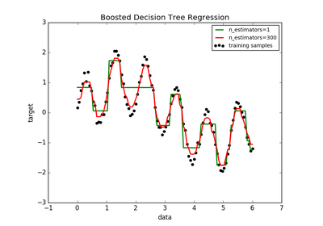
ADA BOOST REGRESSOR

Slide 2
ADA BOOSTER
An Ada Boost regressor is a meta-estimator
That begins by fitting a regressor on the original dataset
And then fits additional copies of the regressor on the same dataset
But where the weights of instances are adjusted according to the error of the current prediction.
As such, subsequent regressors focus more on difficult cases.

Slide 3
ADA BOOSTER
Syntax:
class sklearn.ensemble.AdaBoostRegressor(estimator
=None,*,n_estimators=50,learning_rate=1.0,loss=‘linear’,random_state= None, base_estimator=‘deprecated’)

Slide 4
Parameters
estimator →object, default=None.
The base estimator from which the boosted ensemble is built.
n_estimators→ int, default=50.
The maximum number of estimators at which boosting is terminated. In case of perfect fit, the learning procedure is stopped early.

Slide 5
Parameters
learning_rate →float, default=1.0
Weight applied to each regressor at each boosting iteration. A higher learning rate increases the contribution of each regressor. There is a trade-off between the learning_rate and n_estimators parameters.
loss→{‘linear’, ‘square’, ‘exponential’}, default=’linear’
The loss function to use when updating the weights after each boosting iteration.

Slide 6
Paramters
random_state→int, RandomState instance or None, default=None
Controls the random seed given at each estimator at each boosting iteration. Thus, it is only used when estimator exposes a random_state. In addition, it controls the bootstrap of the weights used to train the estimator at each boosting iteration.
base_estimator→object, default=Non
The base estimator from which the boosted ensemble is built.

